Slide 1
Sociodemographic Characteristics

Slide 2
How much control do you have?
We’ve talked about lots of ways to can enhance our persuasive success.
However, there are things that we can’t do much about, like our gender, age, and our personality traits. These also affect our ability to persuade.
Why should you still want to learn about these?
These same sociodemographic variables affect how we should approach a persuasive situation.

Slide 3
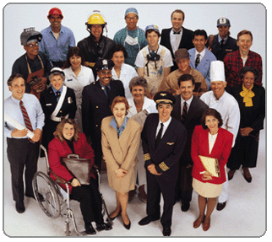
Today’s lecture
The three types of attractiveness (and the variables that affect each one)
Gender
Age
Self-esteem
Dogmatism
Ethnicity
Self-monitoring
Cognitive complexity
Aggression

Slide 4
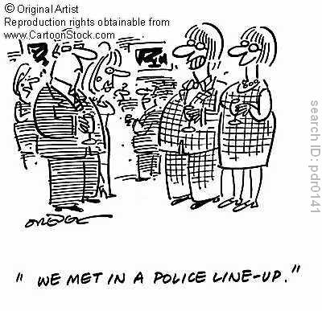
Attractiveness
Dimensions
Social Attractiveness
Physical Attractiveness
Task Attractiveness

Slide 5
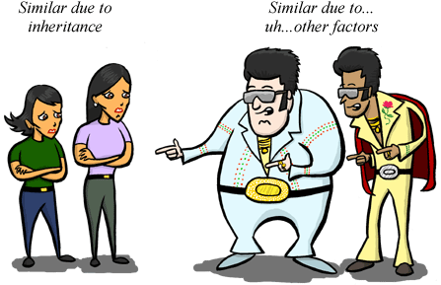
Variables that affect perceived social and physical attractiveness
Similarity
Sociodemographic factors (gender, ethnicity, social class)
Behavioral factors (activities, hobbies)
Communication factors (Ex: extroversion, self-monitoring)
Proximity
Physical distance between communicators
Able to exchange more information, able to experience more rewards/punishments
Physical characteristics
Physical beauty
Height/weight

Slide 6
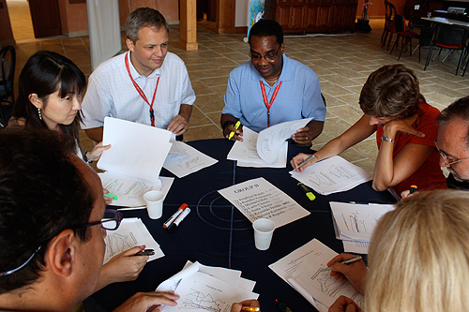
Variables that Affect Task Attractiveness
Perceived competence for a particular job.
“Credibility” in the area in question
Having performed the task successfully in the past
In most instances, intelligence positively influences perceived task attractiveness.
Reliability/predictability is also positively related to task attractiveness.

Slide 7

Gender
Men and women have different preferred strategies for persuading others
Men are “permitted” to be more aggressive
Women tend to use more socially desirable strategies
Males tend to be perceived as being more credible than females, though this can depend on topic.
Recent studies show no differences in persuadability based on gender.

Slide 8
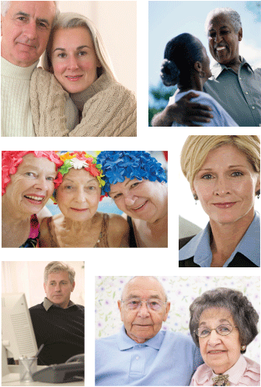
Age
Older people (not elderly!) generally perceived as more credible.
Older people have more complex persuasion strategies.
Young children are more susceptible to persuasion than older people.

Slide 9
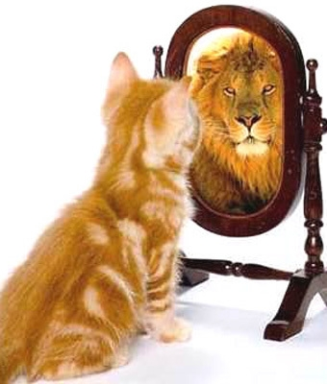
Self-Esteem
People with moderate self-esteem are easier to persuade than people who are either low or high in self-esteem.
People low in self-esteem are overly concerned with appearances. They also have a hard time attending to messages.
People high in self-esteem are more likely to believe that they already hold the correct position.

Slide 10
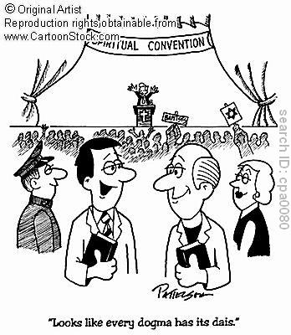
Dogmatism and Authoritarianism
People who are high in dogmatism and authoritarianism are generally closed-minded and tend to follow authority blindly.
They are difficult to persuade-- unless the source is an authority or expert.

Slide 11
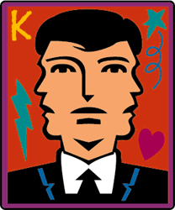
Self monitoring
Self-monitoring is the degree to which we are attuned to how others see us.
High self-monitors tend to be viewed as more socially competent than low self-monitors. ( → persuasion)
High self-monitors are more likely to be persuaded if they believe that changing their attitudes or behaviors would make them look good.
High self-monitors are resistant to persuasion only if they believe that they could look bad if they change.
Low self-monitors are persuaded by argument quality but generally tend to “stick to their guns.”

Slide 12
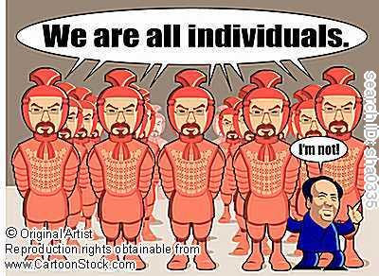
Ethnicity and Culture
Individualistic cultures are more persuaded by appeals to individualism, independence, and personal benefit.
Collectivistic cultures are more persuaded by appeals to harmony, group goals, and concern for others.
We pay more attention to speakers from a different culture.

Slide 13
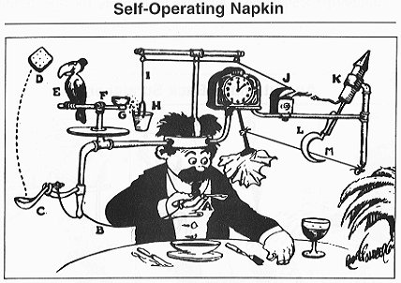
Cognitive Complexity and the Need for Cognition
People who are high in need for cognition are persuaded by strong arguments.
People who are low in NFC are persuaded by peripheral cues.

Slide 14

Aggression
Assertiveness: Speaking up and not being persuaded by unreasonable requests.
Argumentativeness: The tendency to approach (and enjoy) arguments.
Verbal Aggressiveness: The tendency to attack others verbally.
People who are high in assertiveness, argumentativeness, and verbal aggression are more difficult to persuade.

